Slide 1
Strategic Proposal for Predictive Weather Analysis using Machine Learning
Kaci Erwin | June 2024

Slide 2
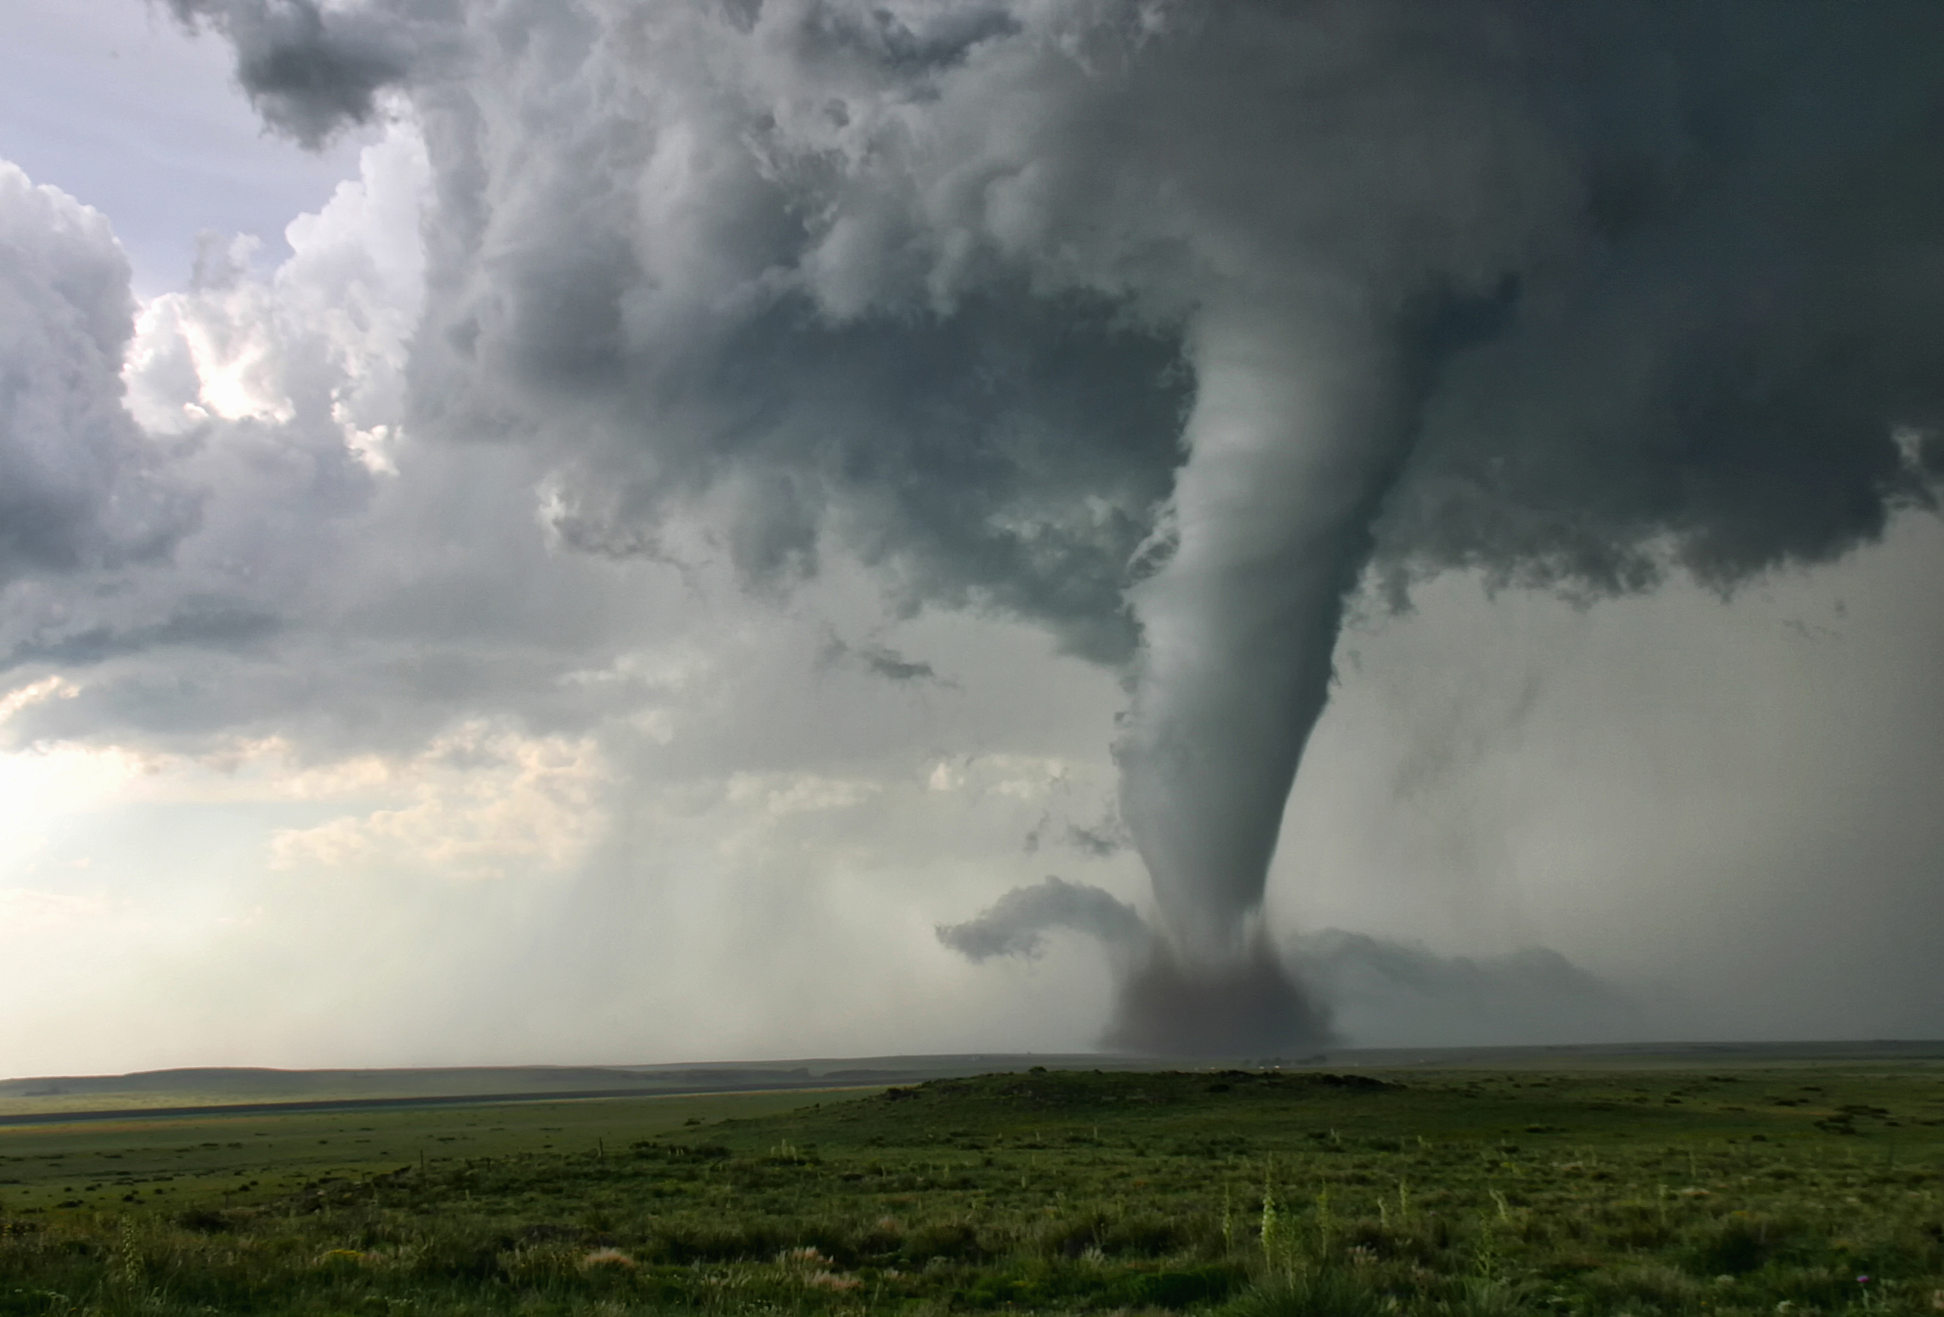





Introduction
Objective
To develop and evaluate machine learning strategies for predicting weather variations to enhance ClimateWins’ forecasting accuracy. ClimateWins’ goals are:
Finding new patterns in weather changes.
Identifying unusual weather patterns.
Determining increase in unusual weather patterns.
Predicting future weather conditions.
Identifying safe places to live in Europe.
Thought Experiments
This presentation will explore three thought experiments designed to harness machine learning technologies for predictive accuracy in weather forecasting.

Slide 3
Machine Learning Approaches
Algorithms Already Explored
Supervised
Linear Regression
K-Nearest Neighbors (KNN)
Decision Tree
Unsupervised
Principal Component Analysis (PCA)
Hierarchical Clustering
Convolutional Neural Networks (CNN)
Random Forests
Methods To Explore
Algorithms
Isolation Forests
Support Vector Machines (SVM)
Local Outlier Factor (LOF)
Long Short-Term Memory (LSTM)
Prophet
Gated Recurrent Units (GRU)
Gradient Boosting Machines (GBM)
Approaches
Data Augmentation with Generative Adversarial Networks (GANs)
Neural Architecture Search (NAS)
Hybrid/Multi-Model Approach

Slide 4







Data
Current Data
The data used by ClimateWins includes a wide range of weather information, such as:
Temperature
Precipitation
Wind speed
Humidity
Data is collected from 18 weather stations across Europe and spans multiple decades.
An extra dataset indicating daily weather pleasantness was used for clustering analysis.
Additional Data
The models could benefit from additional information, such as:
real-time climate monitoring data
socio-economic data
geographic information systems (GIS) data
These would enhance model robustness and predictive accuracy, especially in dynamic weather conditions and diverse regions.

Slide 5
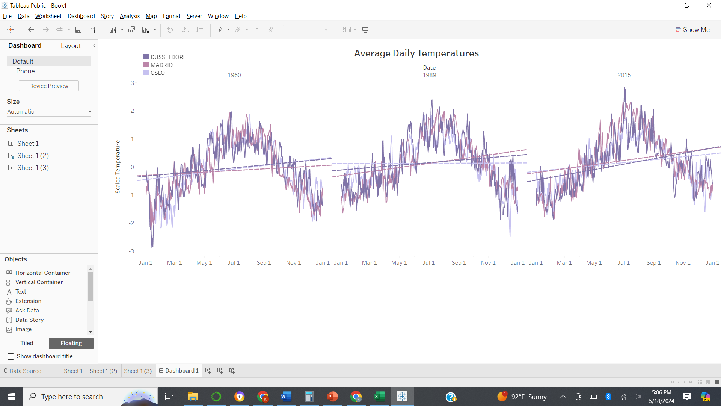
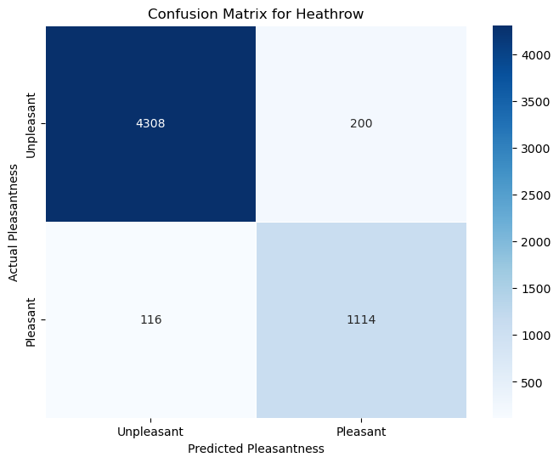
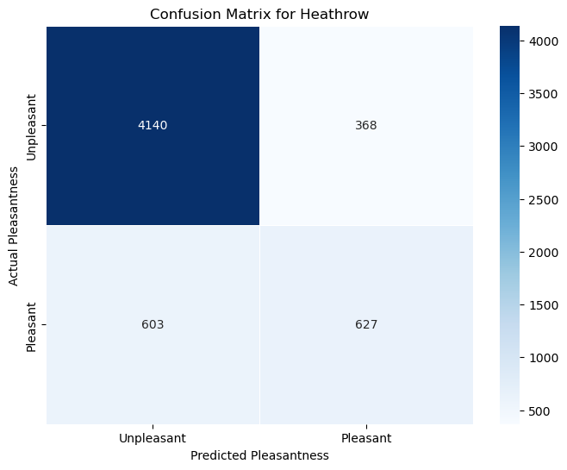
Algorithms Explored – Supervised
Linear Regression
K-Nearest Neighbors
Decision Tree
Findings:
Positive slopes indicate a consistent warming trend.
Temperatures are rising annually across various regions in Europe.
Performance:
High accuracy (>90%) with single location data.
Does not perform well with the entire dataset.
Performance:
High accuracy (>80%) with single location data.
Shows bias towards the dominant class, needs data tuning.

Slide 6
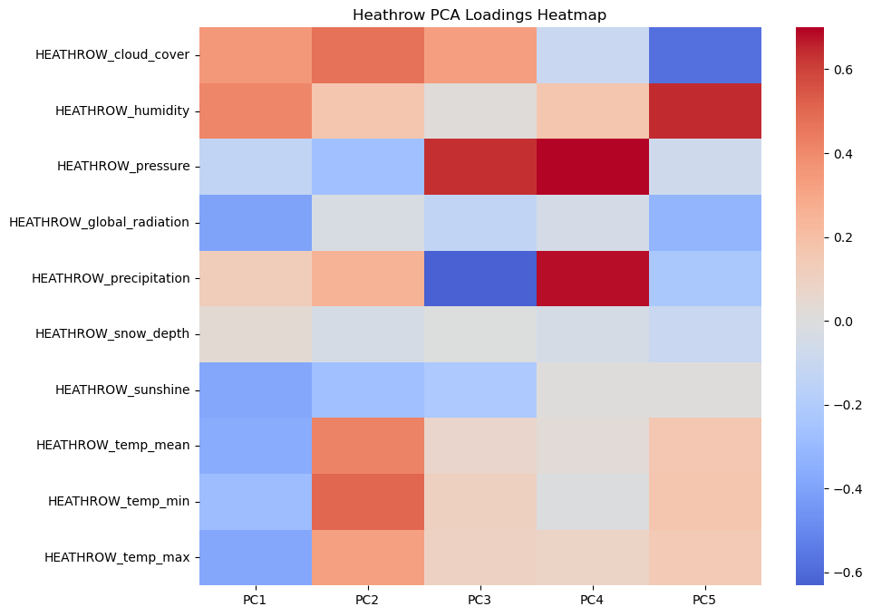
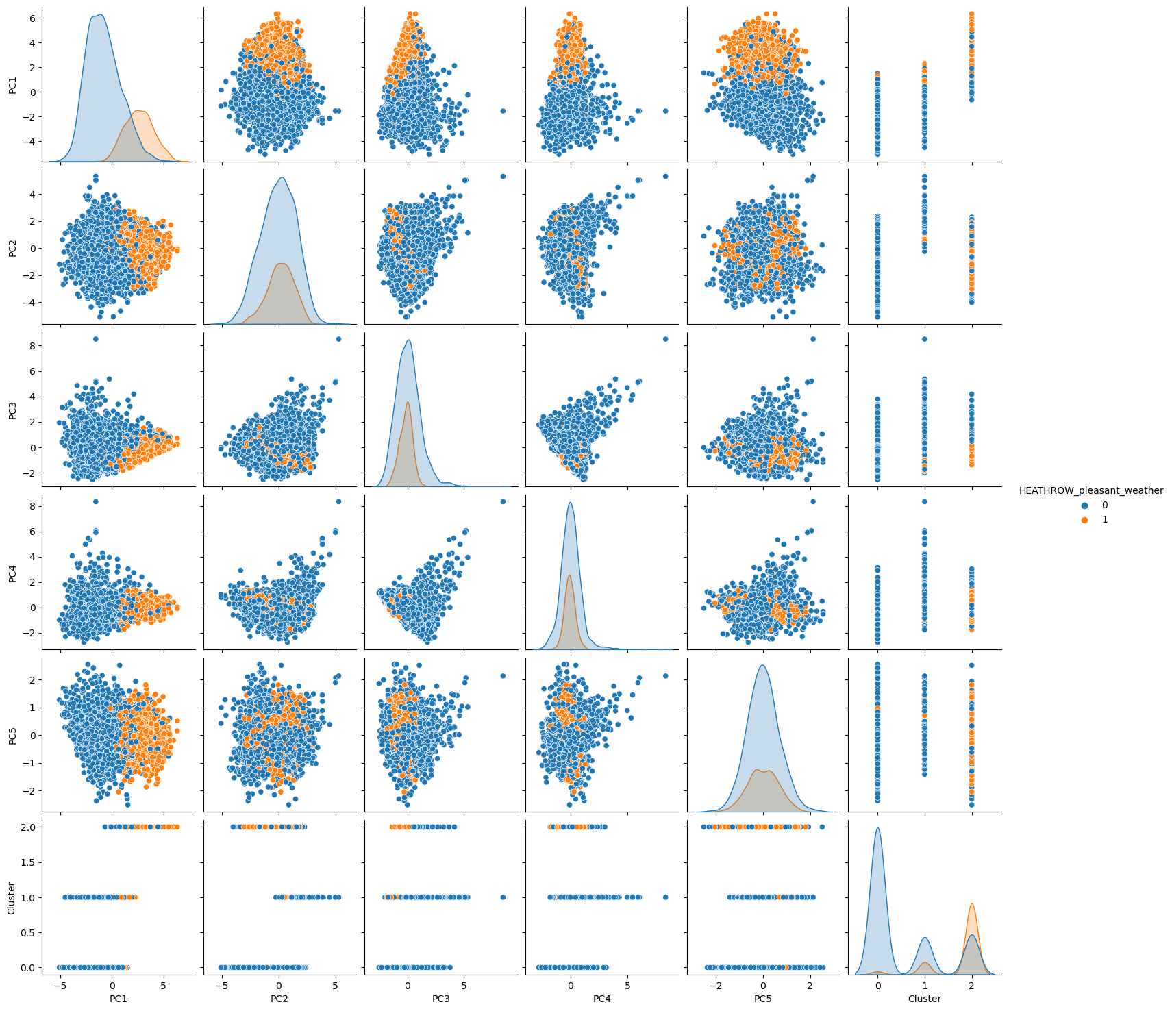
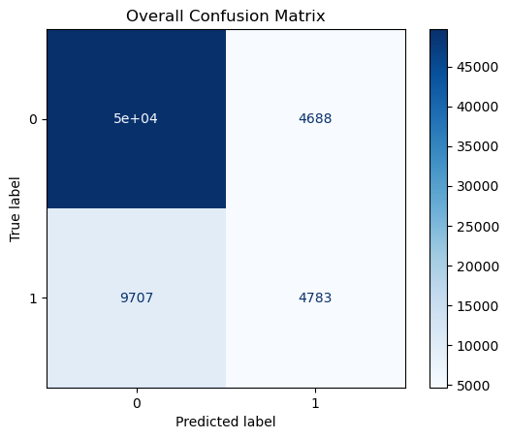
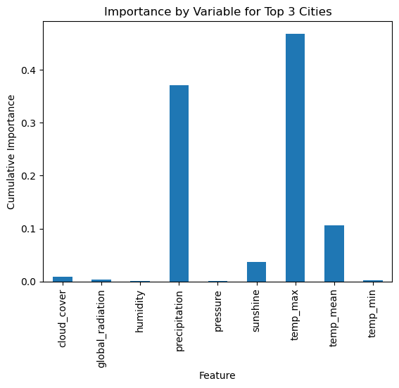
Algorithms Explored – Unsupervised
Principal Component Analysis
Hierarchical Clustering
Convolutional Neural Network
Random Forest
Findings:
Determined the variables contributing most to data variance.
Performance:
Clustering for a full and single location data is incomplete.
Potential for accurate classification with data tuning.
Performance:
High overall accuracy, bias towards the majority class.
Potential for accurate classification with data tuning.
Findings:
Identified key locations and climate variables that contribute most to data variance.

Slide 7
Thought Experiments
I have devised three thought experiments to better understand and predict climate-related phenomena.
Detecting and Analyzing Weather Extremes
Predicting Future Weather Patterns
Identifying Safe Living Locations
Use anomaly detection models on historical climate data.
Utilize time series forecasting models like LSTM and Prophet
Apply deep learning models to assess and predict climate safety.

Slide 8
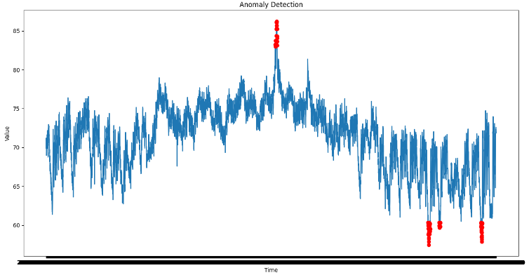
Thought Experiment 1: Detecting and Analyzing Weather Extremes
Objective
Identify and analyze weather patterns outside the regional norm in Europe.
Approach
Identify outliers in the data using anomaly-detection models like
Isolation Forests
One-Class Support Vector Machines (SVM)
Local Outlier Factor (LOF)
Employ Generative Adversarial Networks (GANs) to generate synthetic instances of extreme weather conditions to augment the training dataset to provide a more comprehensive basis for anomaly detection.
Sample Anomaly Detection Plot
Data
Use the existing climate dataset and filter for unusual values in key variables defined as those that fall beyond certain statistical thresholds (e.g., above the 95th percentile or below the 5th percentile).
Augment the dataset with data representing rare but plausible extreme weather scenarios for more robust model training.

Slide 9
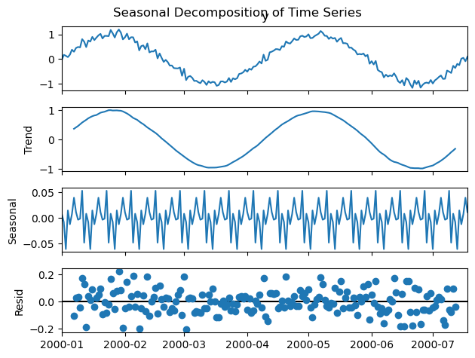
Thought Experiment 2: Predicting Future Weather Patterns
Objective
Generate possibilities for future weather conditions over the next 25 to 50 years.
Approach
To predict future weather conditions, use time series forecasting models like
Long Short-Term Memory (LSTM)
Prophet
Gated Recurrent Units (GRU)
Implement Neural Architecture Search (NAS) to automatically optimize neural network architectures, enhancing the performance of the time-series forecasting models
Sample Time Series Forecasting Plot
Data
The current dataset contains sequential data and is appropriate for use with these suggested models.
Similar climate datasets from other regions can be added to make the models more robust.

Slide 10
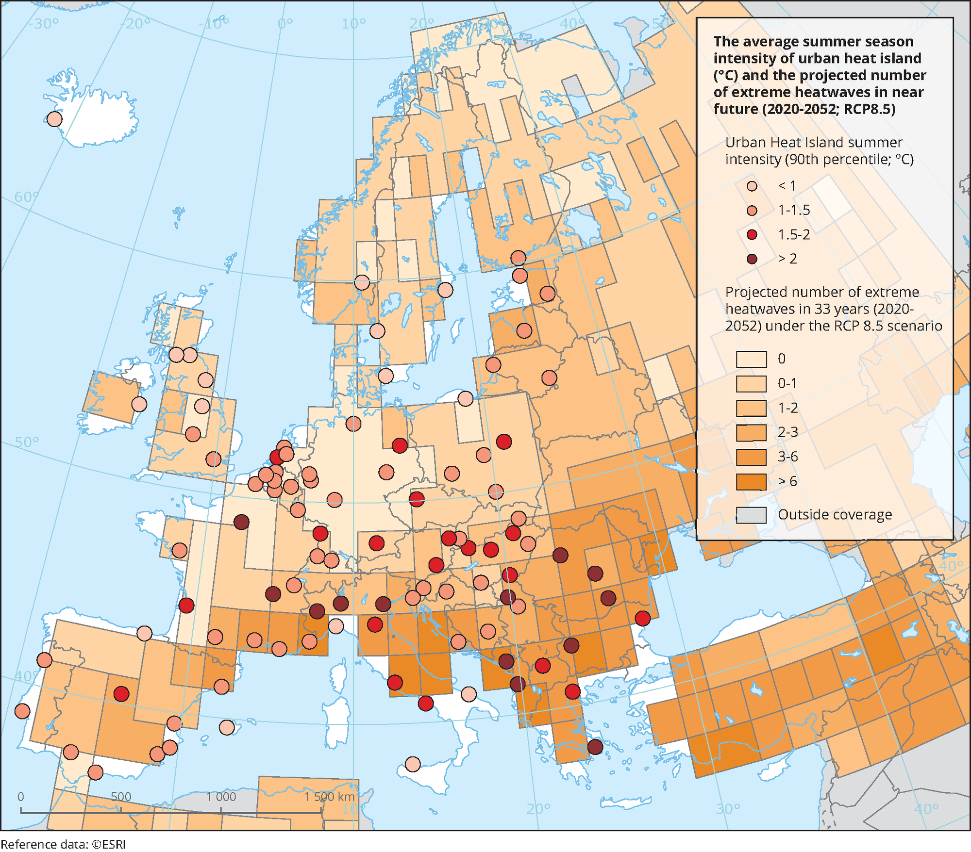
Thought Experiment 3: Identifying Safe Living Locations
Objective
Determine the safest places for people to live in Europe within the next 25 to 50 years.
Approach
Identify key climatic factors for determining safety Using robust algorithms capable of
handling complex relationships such as
Random Forests
Gradient Boosting Machines (GBM)
Support Vector Machines (SVM)
Neural Networks
Use ensemble methods to combine insights from multiple predictive models to assess safety more robustly
Apply deep learning to model complex interactions between climatic factors and human-centric metrics to forecast safe zones.
Sample European Heatmap
Data
Incorporate data on weather-related deaths and weather-related migrations.
Incorporate data on socio-economic or urbanization factors to provide a broader definition of "safe."

Slide 11
Thought Experiment Conclusions
Detecting Weather Extremes
Suggested use of anomaly detection models like Isolation Forests and LOF.
Potential to augment datasets with GANs for improved anomaly detection.
Predicting Future Weather Patterns
Suggested time series forecasting models include LSTM, Prophet, and GRU.
Neural Architecture Search (NAS) recommended to optimize model architectures.
Identifying Safe Living Locations
Proposed use of Random Forests, Gradient Boosting Machines, and ensemble methods.
Integration of socio-economic data for comprehensive safety analysis.
Summary
Most Promising Experiment: Predicting Future Weather Patterns
RATIONALE
Has the potential to provide actionable insights well into the future and is crucial for long-term planning and adaptation strategies.
IMPACT
Improved forecasting can significantly influence policy-making, urban planning, and disaster preparedness, potentially saving lives and resources.
FEASIBILITY
While Quantum ML is still emerging, the groundwork with NAS and existing machine learning frameworks sets a realistic path for development.
DATA
Leverages existing climate data sets, with the potential to seamlessly integrate new data as it becomes available.
Recommendations

Slide 12
Approach
Initial Model Testing
Begin with preliminary testing of suggested models using existing climate dataset.
Evaluate performance and refine models based on initial results.
Data Enrichment
Plan to incorporate real-time climate data, socio-economic data, and GIS data.
Enhance robustness and accuracy of predictive models.
Model Optimization
Utilize Neural Architecture Search (NAS) to optimize model performance.
Apply transfer learning with similar climate datasets for broader applicability.
Integration & Validation
Develop a unified platform to integrate different models and validate predictions.
Continuous monitoring and updating of models based on new data and findings.
Collaboration
Work closely with climatologists, urban planners, and policymakers.
Ensure practical applicability and relevance of the models in real-world scenarios.

Slide 13
Thank You!
You can review the scripts used for this project in this GitHub Repository

